Slide 1

NAME: E.G.PRADEEP ROLL NO : RA2211004050026 DEP: B.TECH.ECE SUB: DESIGN THINKING METHODOLOGY SUB CODE : 21DCS201P

Slide 2
BUISSNESS MODEL CANVAS : The Business Model Canvas (BMC) is a strategic management tool that allows entrepreneurs and businesses to describe, design, challenge, invent, and pivot their business model. It's a visual chart with elements describing a firm's or product's value proposition, infrastructure, customers, and finances. Developed by Alexander Osterwalder and Yves Pigneur, the BMC consists of nine building blocks: 1.Customer Segments: Identifying the different groups of people or organizations you aim to reach and serve. 2.Value Propositions: Describing the products or services you offer that solve problems or satisfy needs for your customer segments. 3.Channels: Outlining how you reach and deliver your value proposition to your customer segments. 4.Customer Relationships: Detailing the types of relationships you establish and maintain with your customer segments.

Slide 3
5.Revenue Streams: Identifying the sources of revenue generated by your business model. 6.Key Resources: Enumerating the assets necessary to deliver your value proposition, reach your customer segments, maintain relationships, and earn revenue. 7.Key Activities: Describing the most important tasks your business needs to perform to operate successfully. 8.Key Partnerships: Identifying the external entities you need to leverage to make your business model work. 9.Cost Structure: Listing all the costs incurred to operate your business model. The BMC is particularly useful in startups and new ventures for quickly assessing and iterating on business ideas. Its visual nature facilitates brainstorming, collaboration, and communication among team members and stakeholders. By filling out the canvas, businesses can gain insights into their operations, potential areas for improvement, and strategies for growth.

Slide 4
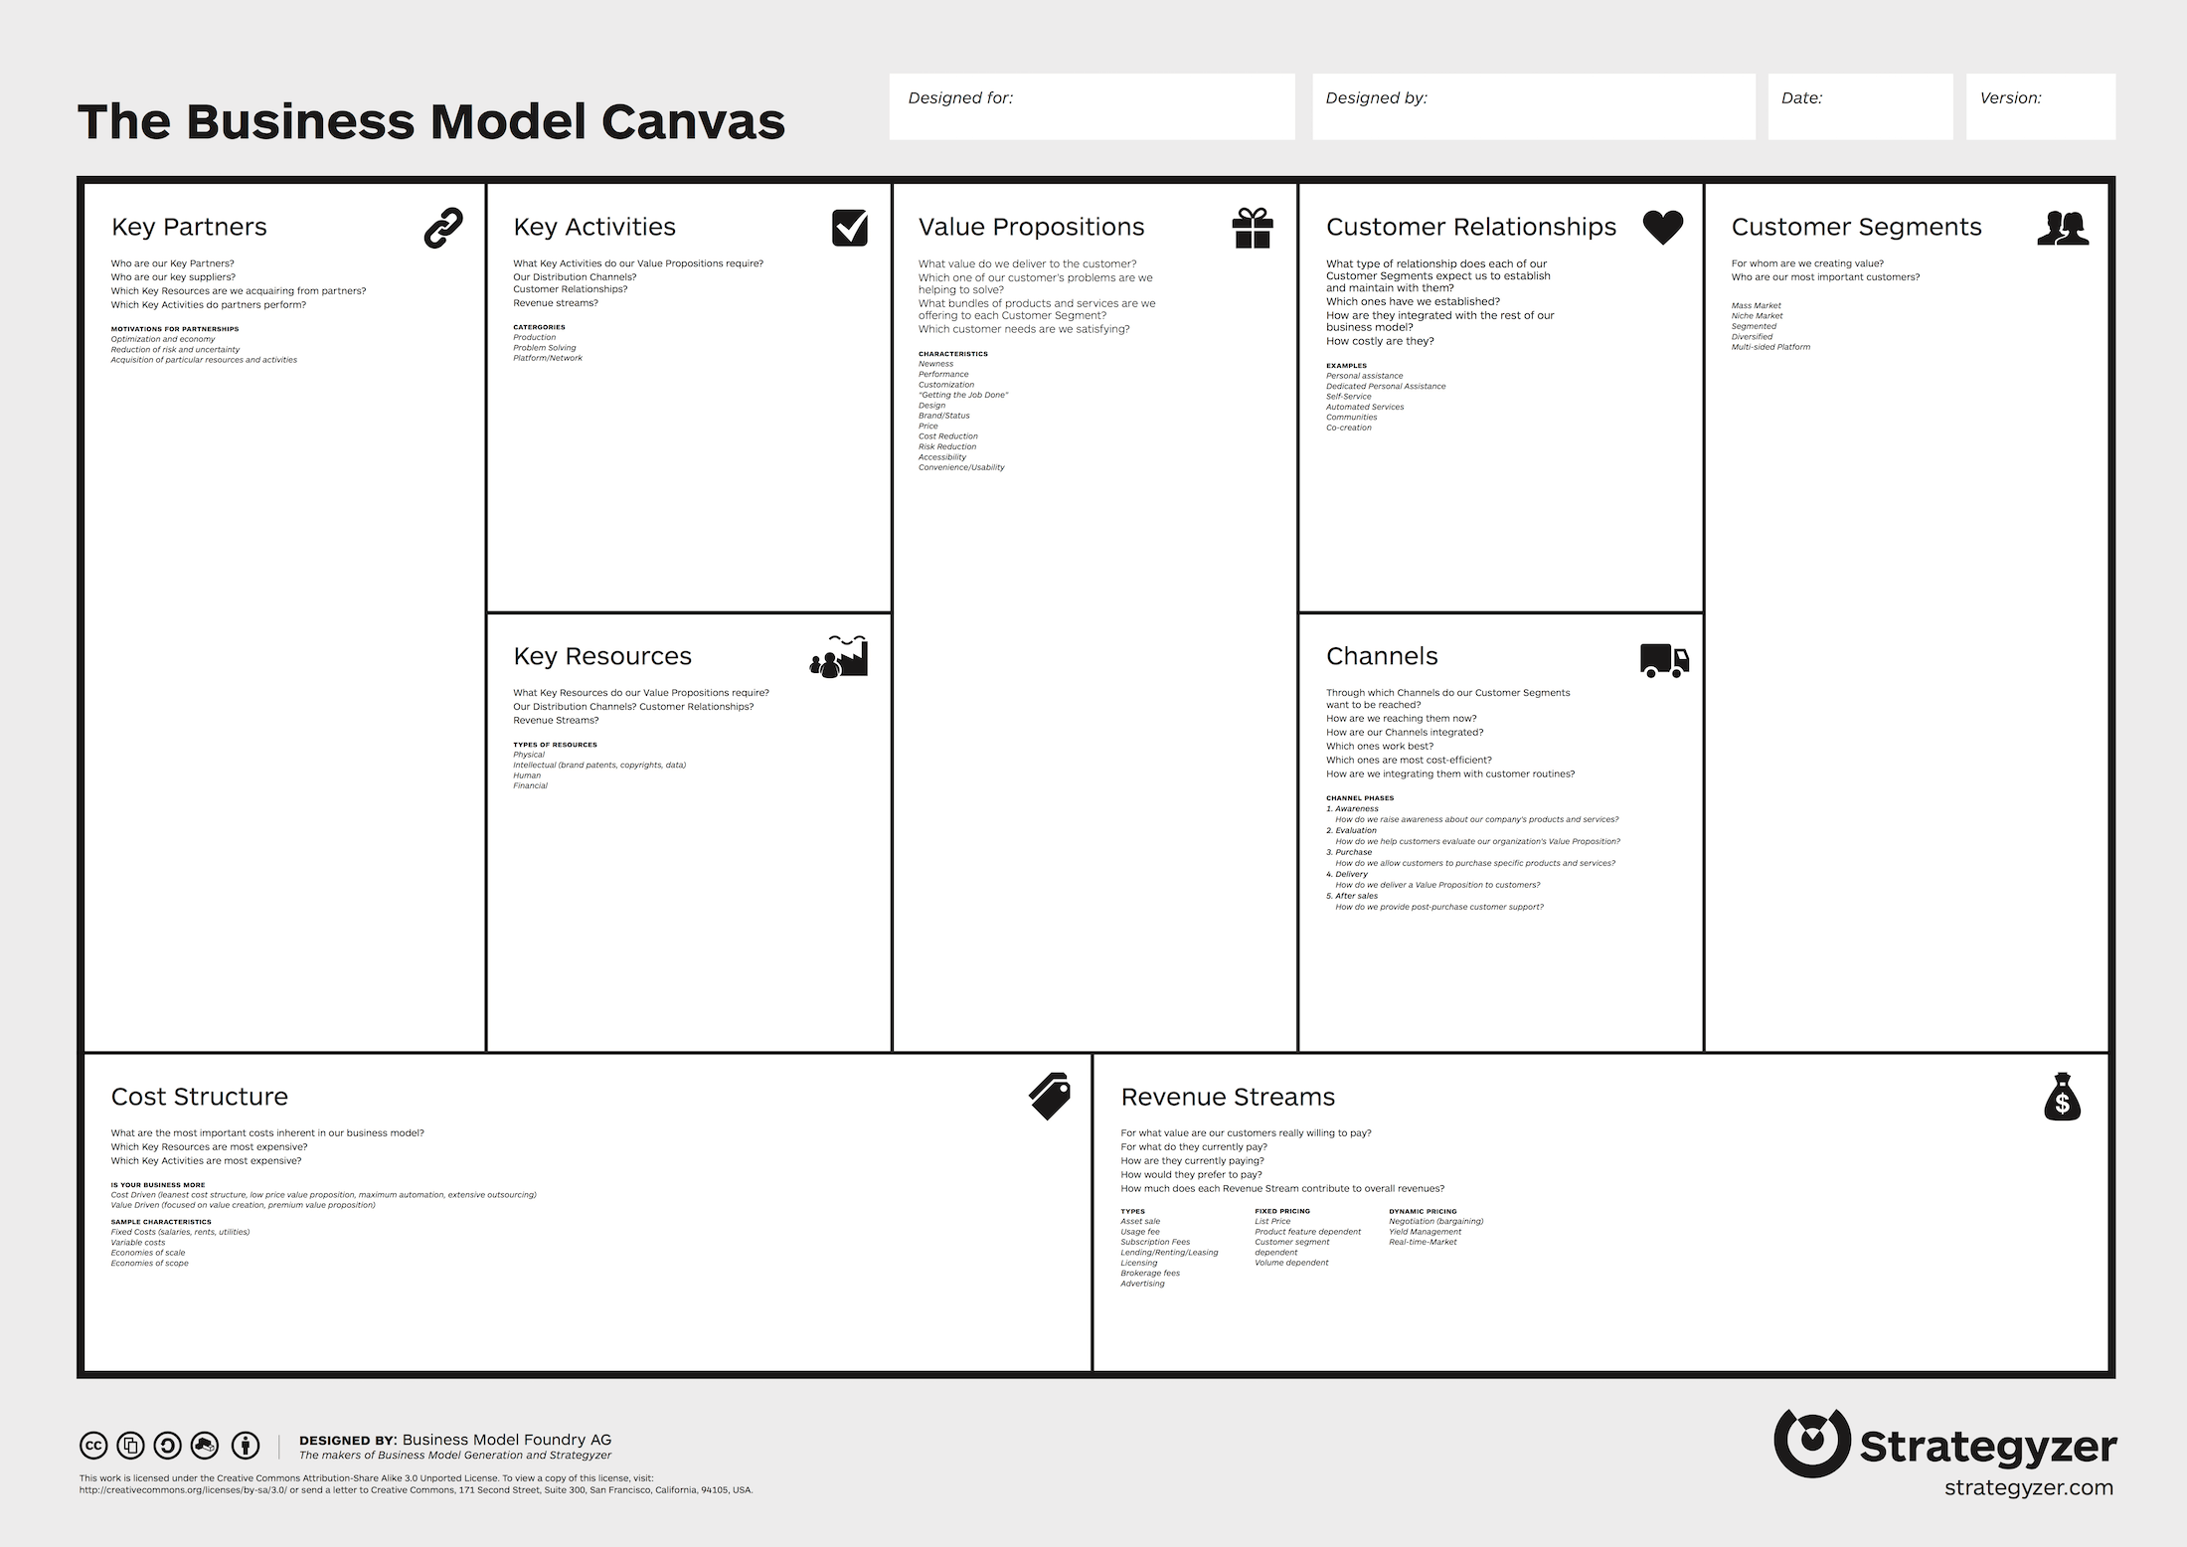
BUISSNESS MODEL CANVAS TEMPLATE:

Slide 5
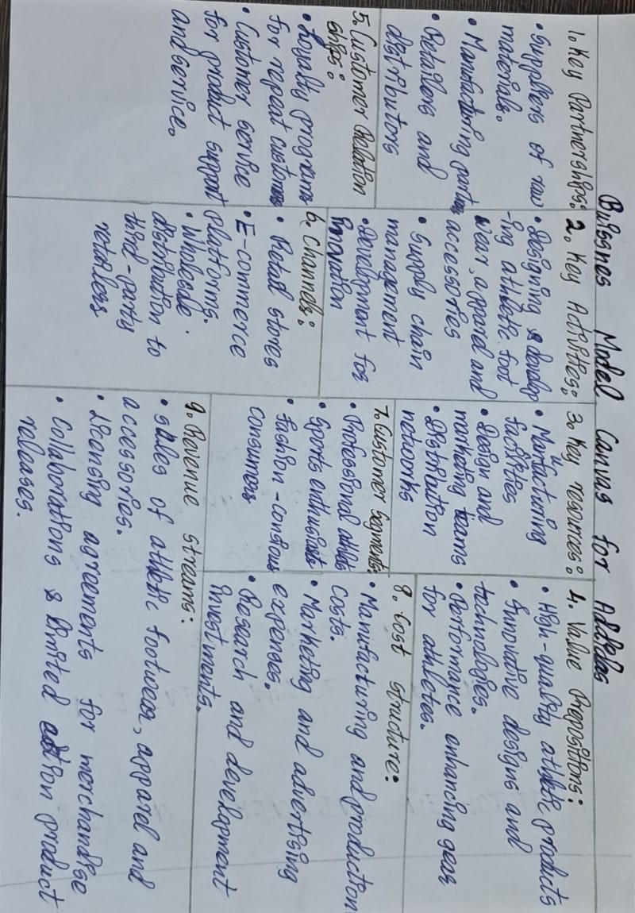
MY ASSIGNMENT :

Slide 6
MIND MAP : 1.A mind map geared towards implementing ideas is a visual representation that organizes the steps and components necessary to turn a concept or plan into reality. 2. It starts with a main idea right in the middle, then branches out into smaller ideas connected to the main one. 3. it generates ideas and exploring different possibilities around a central topic or problem. 4.Mind maps serve as visual aids during presentations, allowing presenters to organize key points, facts, and concepts in a structured and engaging manner. 5.Mind maps help in defining and visualizing personal or professional goals, breaking them down into actionable steps, and tracking progress over time.

Slide 7
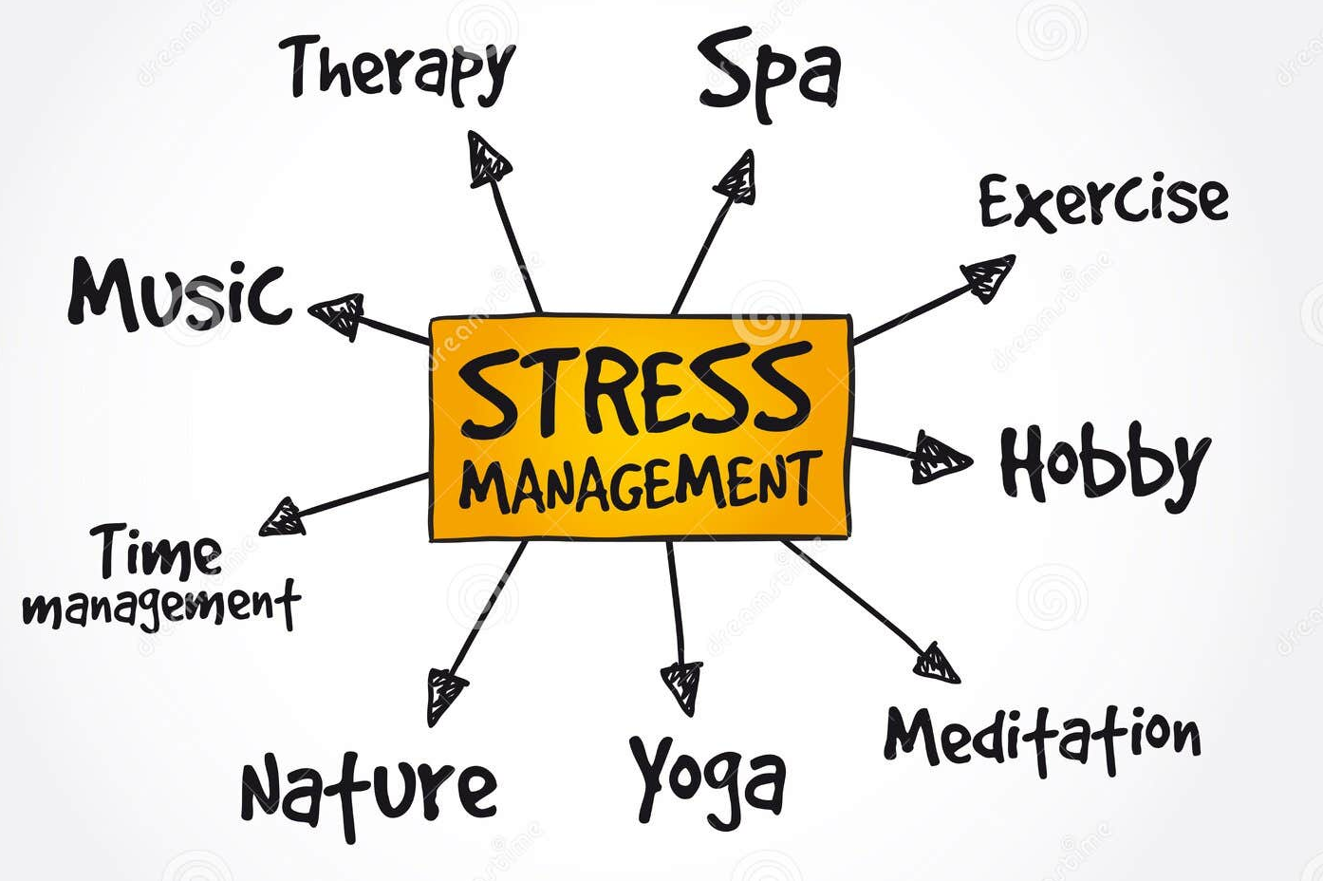
MIND MAP EXAMPLE :

Slide 8
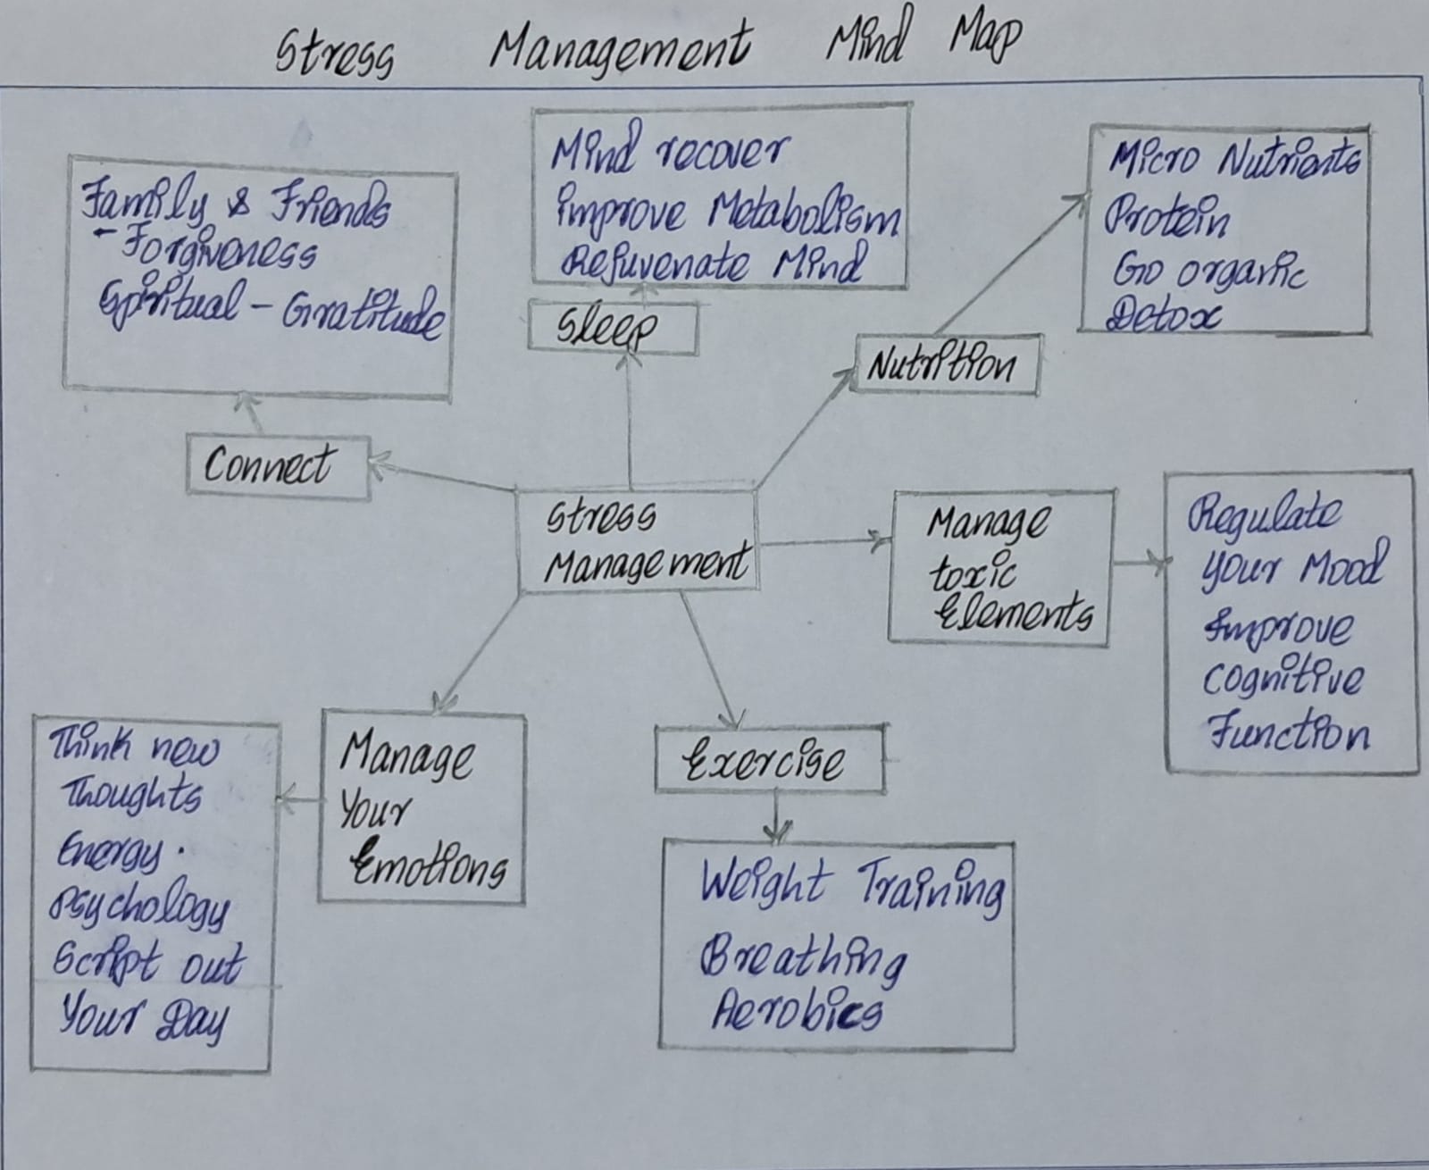
MY ASSIGNMENT :

Slide 9
EMPATHY: 1.Empathy is the ability to understand and share the feelings, emotions, and perspectives of others. It involves putting oneself in someone else's shoes, seeing the world from their point of view, and feeling what they are feeling. 2.Empathy goes beyond sympathy, which is merely acknowledging and feeling sorry for someone's pain or difficulties. EMPATHY MAPPING CANVAS : 1.An empathy mapping canvas is a visual tool used to understand and document the thoughts, feelings, actions, and experiences of a particular user or customer. 2. It typically consists of a simple framework divided into sections representing different aspects of the user's experience.

Slide 10
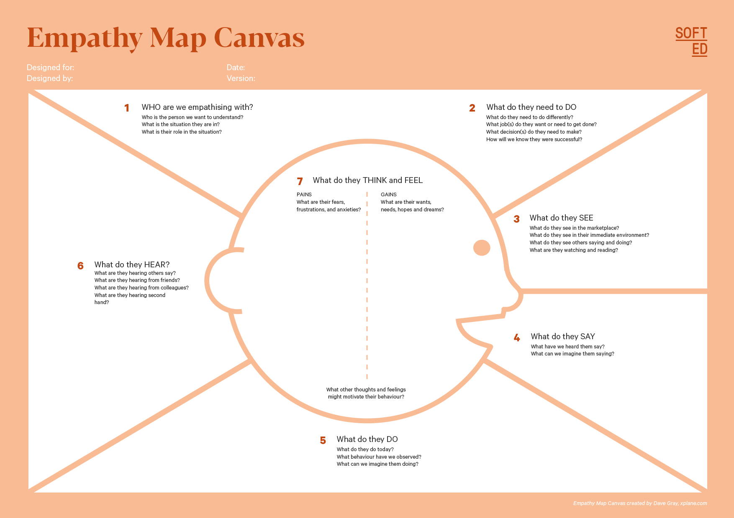
EMPATHY MAPPING CANVAS EXAMPLE :

Slide 11
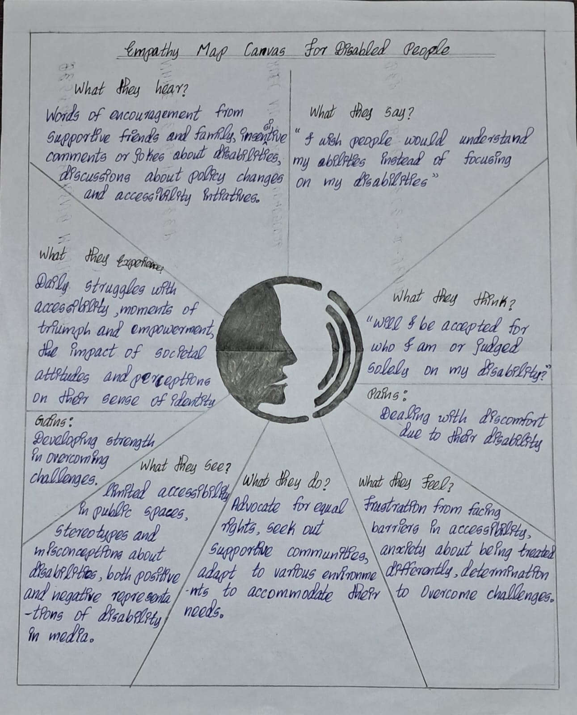
MY ASSIGNMENT :

Slide 12
VISUALIZATION OF STAKEHOLDERS : 1.A STACKEHOLDER IS A PERSON,GROUP,OR ORGANIZATION THEIR OPINION ARE IMPORTANT AND CAN IMPACT THE BUISENESS’S ABILITY TO ADVANCE PRODUCT STATERGY,CREATE A ROADMAP,AND EXECUTE IT. 2.STACKHOLDERS CAN BE INTERNAL OR EXTERNAL,AND CAN HAVE A DIRECT OR INDIRECT INFLUENCE ON THE ORGANIZATION’S ACTIVITIES. 3.Stakeholders are often responsible for making key decisions throughout the project lifecycle. This includes decisions related to project planning, resource allocation, risk management, and overall strategy. 4.. They provide input based on their interests, needs, and expectations, helping to shape the direction of the project. 5.Stakeholders typically monitor the progress of the project to ensure that it is on track to achieve its objectives.

Slide 13
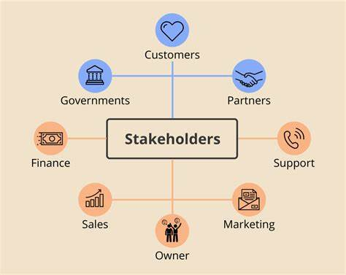
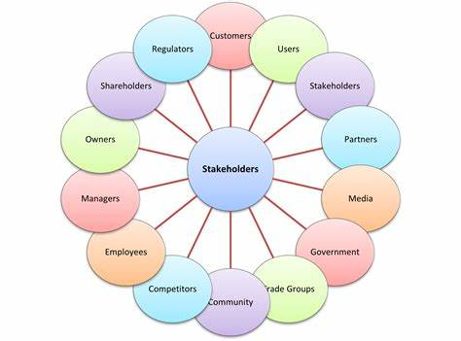

Slide 14
PROBLEM STATEMENT CANVAS : 1. provides a clear and concise overview of the problem, including its nature, scope, and impact on stakeholders. 2. It helps US clearly define and articulate the problem they are facing, providing a structured framework for understanding its nature, scope, and impact. 3. It supports decision-making by providingUS with a comprehensive overview of the problem and its implications, enabling informed decision-making about resource allocation, priorities, and courses of action. 4.the Problem Statement Canvas is a valuable tool for problem identification, analysis, and solution development, empowering stakeholders to address complex problems more effectively and systematically across a wide range of contexts and applications.

Slide 15
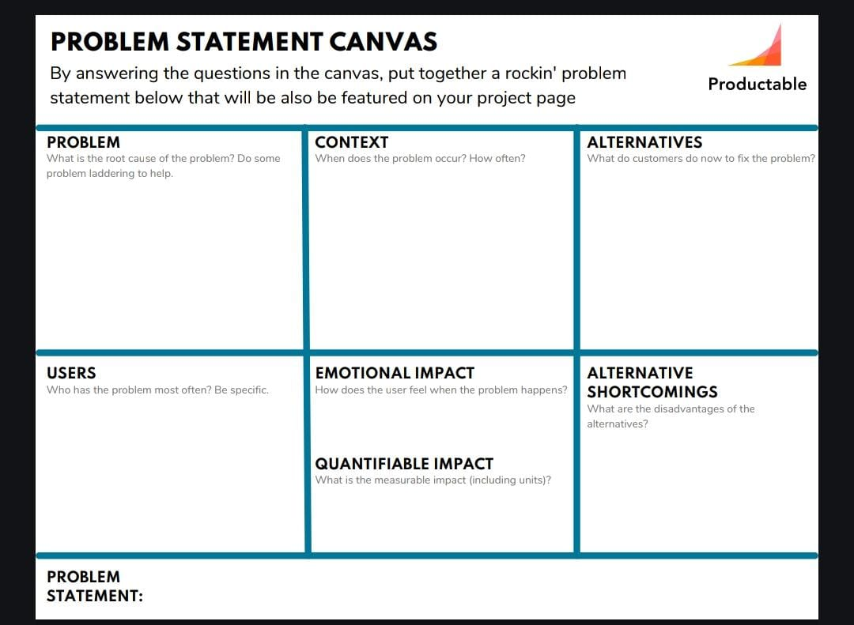
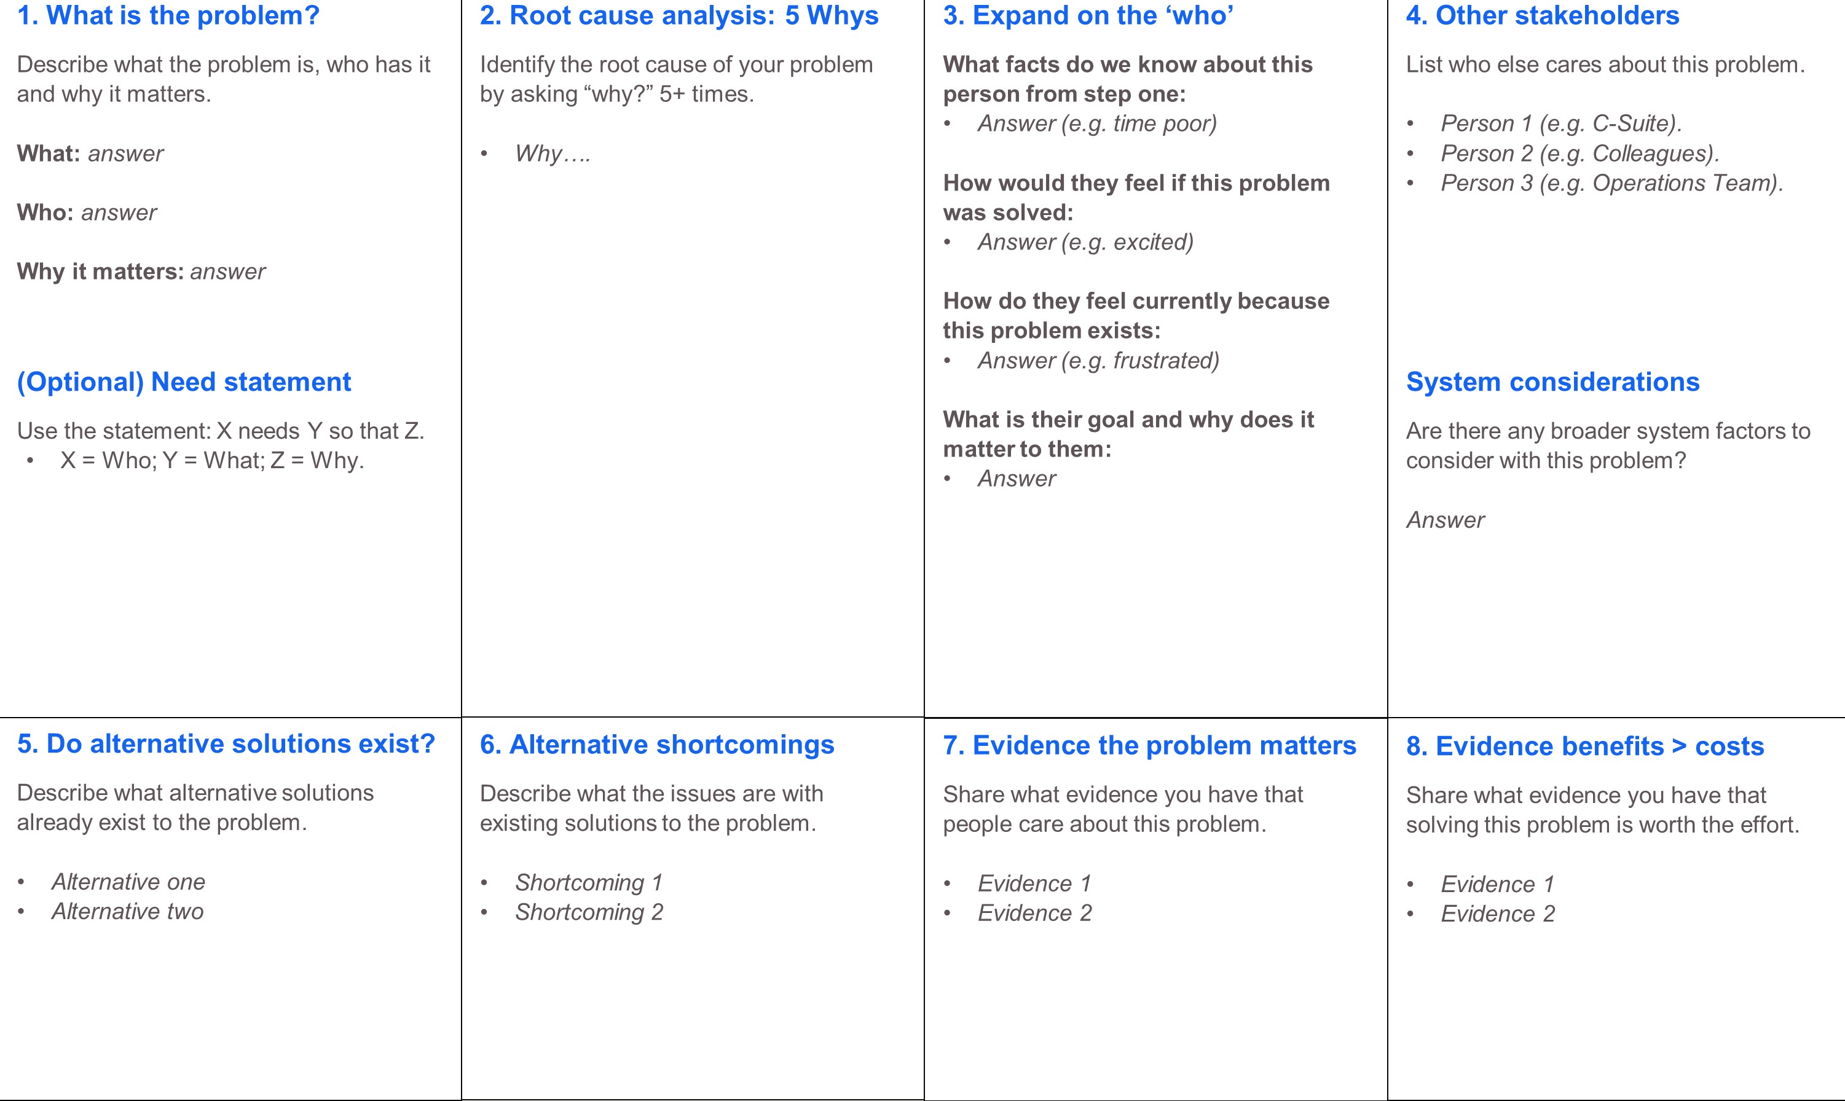
PROBLEM STATEMENT CANVAS TEMPLATE :

Slide 16
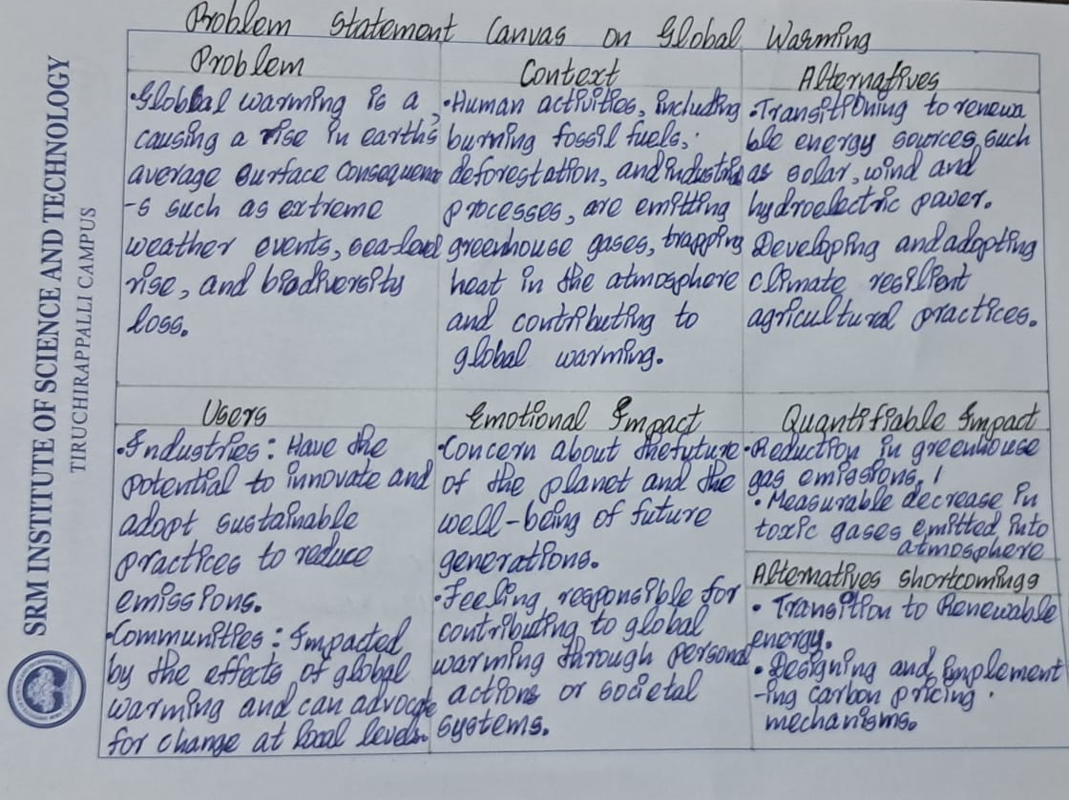
MY ASSIGNMENT :

Slide 17
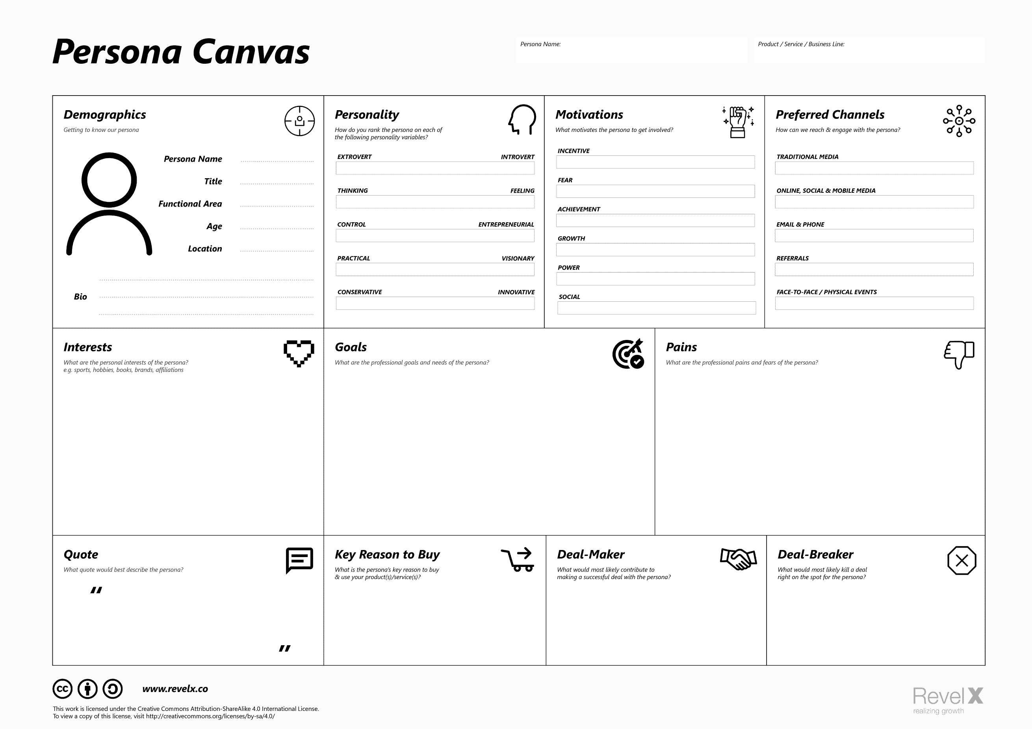
PERSONA CANVAS TEMPLATE:

Slide 18
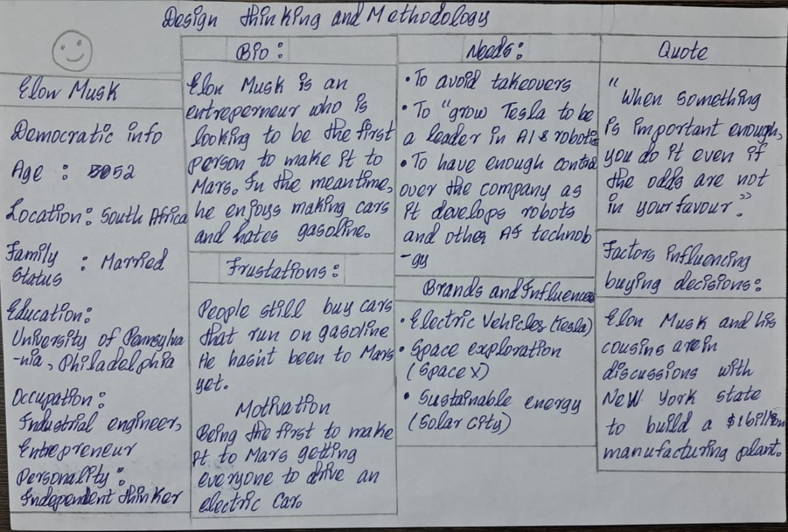
MY ASSIGNMENT :

Slide 19
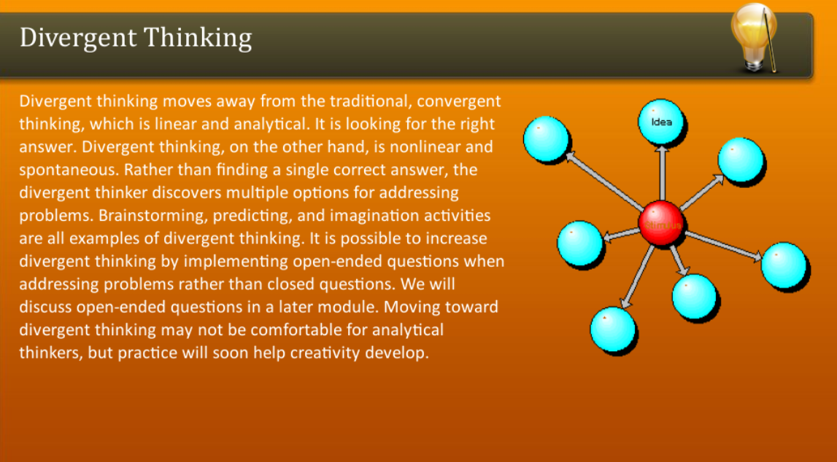

Slide 20
DIVERGENT THINKING TOOLS : Divergent thinking tools are techniques or methods used to stimulate creative and innovative thinking by encouraging the exploration of multiple possibilities and generating a wide range of ideas. Here are some common divergent thinking tools: 1.Brainstorming: A group technique where participants generate ideas freely and without judgment, aiming to produce a large quantity of ideas in a short amount of time. 2.Mind Mapping: A visual tool used to organize thoughts and ideas around a central concept, allowing for the exploration of connections and associations between different concepts. 3.SCAMPER: An acronym for Substitute, Combine, Adapt, Modify, Put to Another Use, Eliminate, and Reverse, which provides prompts to help generate new ideas by modifying existing ones. 4.Random Word or Picture Prompts: Introducing random words or images as stimuli to inspire new ideas and associations that may not have been considered otherwise. 5.Role-playing: Encouraging individuals to adopt different perspectives or personas to generate ideas from various viewpoints.

Slide 21
6.Reverse Thinking: Considering the opposite or reverse of conventional wisdom to provoke new insights and solutions. 7.Provocation: Introducing provocative statements or questions to challenge assumptions and stimulate unconventional thinking. 8.Analogies: Drawing parallels between unrelated concepts or domains to generate novel ideas. 9.Lotus Blossom Technique: A structured brainstorming method that involves systematically expanding upon a central idea by exploring its various components and associations. 10.Free Writing: A technique where individuals write continuously without stopping or censoring themselves, allowing for the exploration of ideas without judgment.

Slide 22
MAIN FEATURWES OF DIVERGENT THINKING : 1.IT IS FREE FLOWING CHAIN OF IDEAS. 2.IT HAPPENS IN NON-LINEAR MANNER ,AS IT IS DOES NOT FOLLOW ANY PARTICULAR SEQUENCE OF THINKING. 3.MULTIPLE IDEAS CAN EMERGE AT THE SAME TIME,RATHER THAN ONE IDEA COMING UP ONLY AFTER THE OTHER HAS OCCURED. 4.NON-LINEAR ALSO MEANS THAT MULTIPLE SOLUTIONS ARE THOUGHT OF AND EXPLORED AT THE SAME TIME. 5.THIS HAPPENS IN A VERY SHORT AMOUNT OF TIMEAND UNEXPECTED CONNECTIONS

Slide 23
CONVERGENT THINKING: 1.CONVERGENT THINKING IS JUST OPPOSITE OF DIVERGENT THINKING. 2.THE CONCEPT OF CONVERGENT THINKING: ~THE DESIGN THINKER SHOULD GO THROUGH ALL POSSIBLE SOLUTIONS THOUGHT DURING DIVERGENT SOLUTIONS. ~HE SHOULD COME UP WITH CORRECT SOLUTION. 3.THE THINKER IS GENERALLY SUPPOSED TO COME WITH A SINGLE,WELLESTABLISHED,BEST POSSIBLE SOLUTION TO A PROBLEM. 4.IT REQUIRES SPEED,ACCURACY,EFFICIENCY,LOGICAL REASONING AND TECHNIQUES. 5.A THINKER IS SUPPOSED TO RECOGNIZE THE PATTERNS,REAPPLY A FEW TECHNIQUESAND ACCUMULATE AND ORGANIZE STORED INFORMATION.

Slide 24
CONVERGENT THINKING TOOLS : Convergent thinking tools are techniques or methods used to focus and narrow down options, ideas, or solutions to identify the best or most optimal outcome. Unlike divergent thinking, which involves generating multiple possibilities, convergent thinking aims to select the most appropriate option from among those generated. Here are some common convergent thinking tools: 1.Decision Matrix: A tool used to systematically evaluate and compare multiple options based on pre-defined criteria, helping to prioritize and select the best solution. 2.SWOT Analysis: An acronym for Strengths, Weaknesses, Opportunities, and Threats, used to assess the internal and external factors affecting a decision or solution, helping to identify the best course of action. 3.Pareto Analysis: Also known as the 80/20 rule, this tool helps identify the most significant factors contributing to a problem or situation, enabling prioritization of efforts on those areas that yield the greatest impact.

Slide 25
4.Cost-Benefit Analysis: A method used to evaluate the potential costs and benefits associated with different options or decisions, helping to determine the most economically viable or advantageous choice. 5.all.Decision Trees: A visual tool used to map out the possible outcomes and decisions in a structured manner, facilitating the identification of the most favorable path forward based on probabilities and potential consequences. 6.Force Field Analysis: A technique used to identify the driving forces (positive factors) and restraining forces (negative factors) influencing a decision or situation, helping to assess the balance between them and determine the feasibility of a particular course of action. 7.Criteria-Based Decision Making: Establishing clear criteria or parameters for evaluating options and systematically comparing them against these criteria to determine the best choice.

Slide 26
8.Multi-Voting: A technique used to prioritize options by allowing individuals to allocate a limited number of votes among their preferred choices, helping to identify the most favored option among a set of alternatives. 9.Weighted Decision Matrix: Similar to a decision matrix, but with assigned weights to different criteria based on their relative importance, enabling a more nuanced evaluation and selection process. 10.Pairwise Comparison: A method for systematically comparing each option against every other option in a pairwise fashion, helping to identify the option that is most preferred over

Slide 27
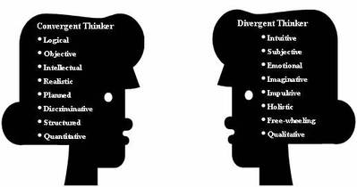
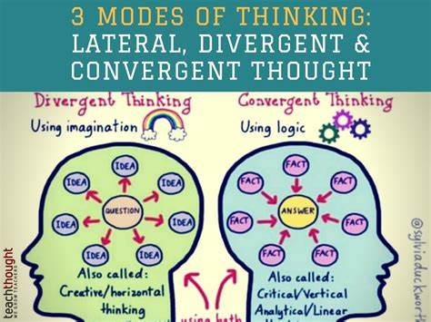

Slide 28
THANK YOU

